Slide 1

Distributed Conflict Base Search DCBS
Uriel Zaed
Ran Weissman

Slide 2
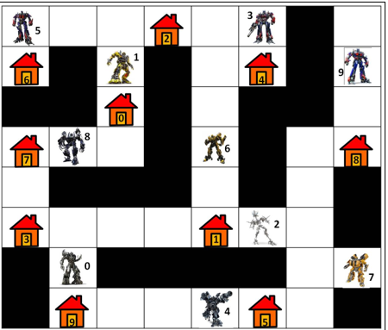
Multi Agent Path Finding
Input
A map with N locations
A set of K agents – each with start and goal state
Task
Find a path for each agent without collision

Slide 3
Conflict Base Search - CBS
CBS: general idea
Plan for each agent individually
Validate plans
If the plans of agents A and B conflict
Constrain A to avoid the conflict
or
Constrain B to avoid the conflict

Slide 4
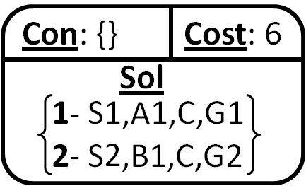
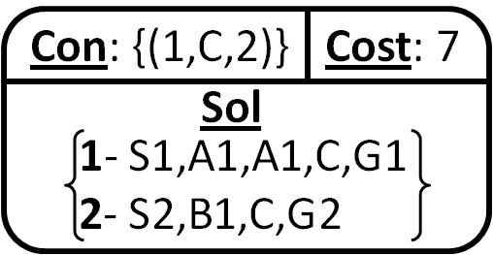
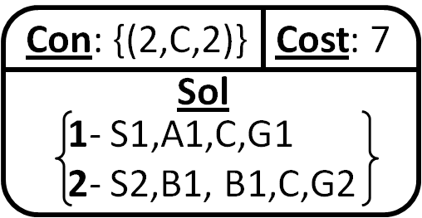
CBS – Tree Search
Conflict
{1,2,C,2}
Conflict: [agent A, agent B, location X, time T ]
Constraint: [agent A, location X, time T]
In bottlenecks: use CBS
CBS: exponential in #conflicts

Slide 5
Distributed Conflict Base Search - DCBS
DCBS: general idea
Each agent plan individually - broadcast all
After get all plans:
If Valid plans - broadcast all
else if agent has no conflicts - broadcast all
else agent has conflict
Constrain agent to avoid the conflict
and
broadcast to other agent to avoid the conflict
Planning - Distributed

Slide 6
Message Types
Path For Agent Message
Information: Path
Declare Solution Message
Information: Valid plans
Declare Conflict Message
Information: CBS node, Conflict
Declare Others Conflict Message
Information: CBS node

Slide 7
Broadcast Conflict
Agent 1
Agent 2
Conflict
{1,2,C,2}

Slide 8
Broadcast others Conflict
Agent 1
Agent 2
Agent 3
Agent 4
Con:{}
Cost: 16
Con:{}
Cost: 16
Con:{}
Cost: 17
Con:{}
Cost: 17
Sol
Sol
Sol
Sol
1 - S1,A1,C,G1
2 - S2,B1,C,G2
3 - S3,R1,E,G3
4 - S4,D1,E,G4
1 - S1,A1,C,G1
2 - S2,B1,C,G2
3 - S3,R1,E,G3
4 - S4,D1,E,G4
1 - S1,A1,C,G1
2 - S2,B1,B1,C,G2
3 - S3,R1,E,G3
4 - S4,D1,E,G4
1 - S1,A1,C,G1
2 - S2,B1,B1,C,G2
3 - S3,R1,E,G3
4 - S4,D1,E,G4
Con:{(1,C,2)}
Cost: 17
Con:{(2,C,2)}
Cost: 17
Con:{(3,E,2)}
Cost: 18
Con:{(4,E,2)}
Cost: 18
Sol
Sol
Sol
Sol
1 - S1,A1,A1,C,G1
2 - S2,B1,C,G2
3 - S3,R1,E,G3
4 - S4,D1,E,G4
1 - S1,A1,C,G1
2 - S2,B1B1,,C,G2
3 - S3,R1,E,G3
4 - S4,D1,E,G4
1 - S1,A1,C,G1
2 - S2,B1B1,,C,G2
3 - S3,R1,R1,E,G3
4 - S4,D1,E,G4
1 - S1,A1,C,G1
2 - S2,B1B1,,C,G2
3 - S3,R1,E,G3
4 - S4,D1,D1,E,G4

Slide 9
Experiment Parameters
Input parameters:
Map from Benchmark: random-32-32-10 (Grid 32x32)
Obstacle Density: 10%
Agents: 2 - 50
Previous data result - algorithm to compare:
CBS
Compering parameters:
Runtime
Success

Slide 10
Results

Slide 11
Future Work
Extend the experiment over diversity maps and Num of agents
Reduce Sum of Messages
Conclusion for DCBS

Slide 12
Thanks
QUESTIONS?

